Slide 1
Wings of Co-Creation:
Human + AI Level Design Through Play
yy
Group 11: Aparajita Saha (s4009762), Ekansh Khanulia(s4336089)
Nallathambi Vethiappan(s4577663), Deepak Somesh K J (s4587243)

Slide 2
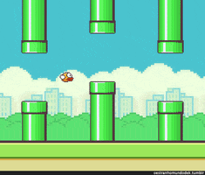
AI- powered Flappy Bird Game
Dynamic themes (day, night, space, hell)
Procedural pipes (zigzag, sloped, random)
Adjustable difficulty + speed scaling

Slide 3
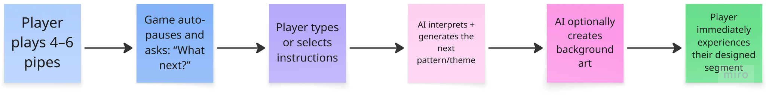
The Vision & How the AI Understands Creativity
A Game That Co-Creates With You
Gameplay becomes a creative dialogue
Player influences level design moment-to-moment
Human imagination + Generative AI = evolving game world

Slide 4
Any questions?

